Slide 1
IOWA LIQUOR SALES
This is Data Analyst project, it will display about liquor sales from retail stores in the state of Iowa for the past 2 years. This data will include information such as liquor type/category, sales volume, profit and store location.
The main goal of the project is to analyze the profits and trends of liquor sales in Iowa during 2021 and 2022.

Slide 2
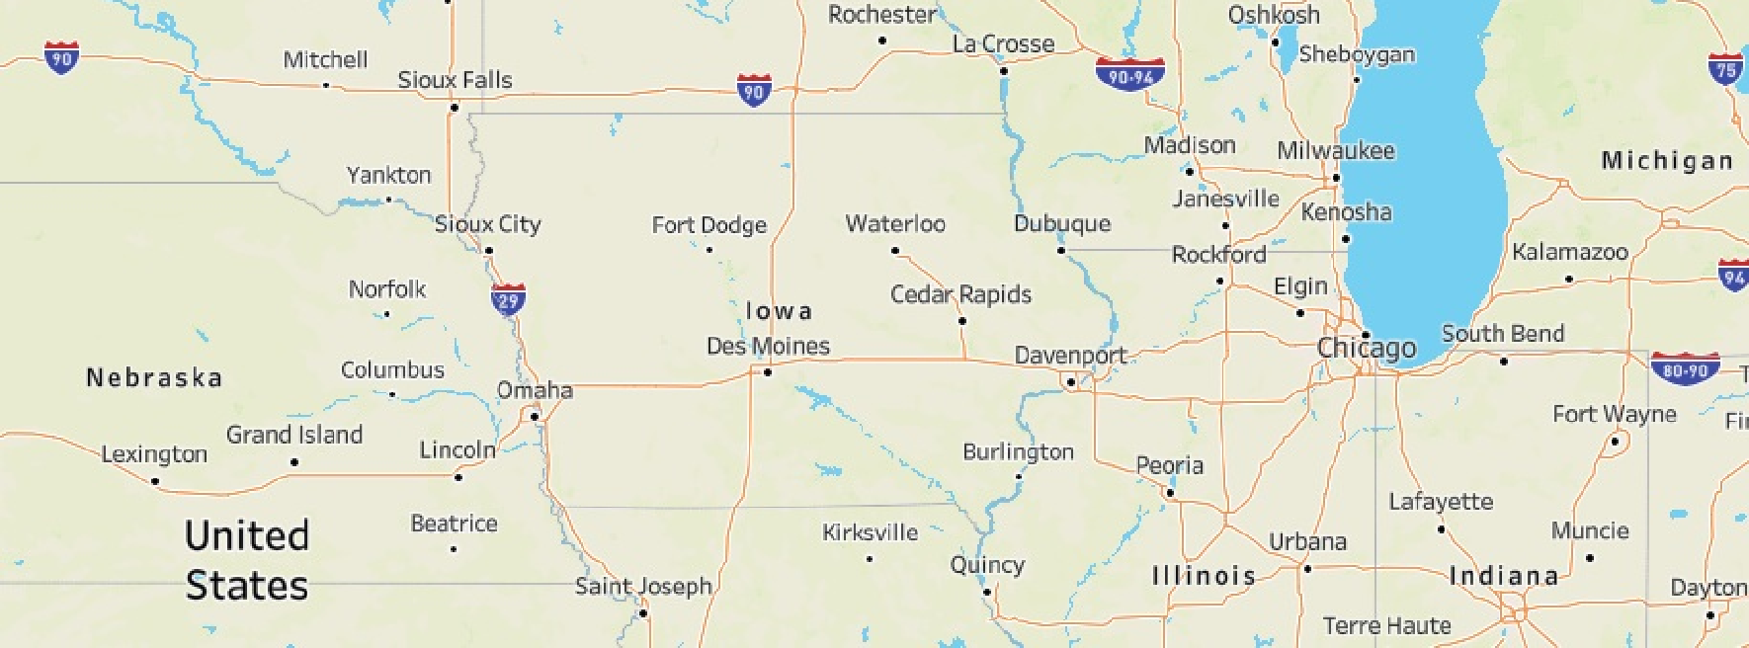

IOWA Liquor Sales in 2021-2022
Top 15 Liquor Sales in IOWA
Sales_permonth
City
All
2,075,380
2,164,311
2,037,587
2,184,459
8M
2,075,586
1,931,451
1,963,992
1,913,507
1,951,883 1,901,532
1,814,044
1,681,405
1,850,121
1,745,910
1,944,380
6M
1,784,282
1,849,796
1,787,378
1,757,205
1,798,640
1,800,499
Sale Dollars
1,484,693
4M
1,541,547
4,679,614
6,481,066
2M
4,479,034
0M
March 2020
June 2020
September 2020
December 2020 March 2021
June 2021
September 2021
December 2021
© 2023 Mapbox © OpenStreetMap
Month of Date
Most proﬁtable Category
Category
Most proﬁtable item
Proﬁt
_{2,566,030}2,588,251
2,422,924
2,764,776
2,567,248
2,662,182
American Vodkas
9,595,856
2500K
2,435,695
2,386,255
2,290,294
2,329,184
2,154,259
2,425,4132,438,009
Canadian Whiskies
6,648,205
Hawkeye Vodka
2,304,316
2,319,859
2,376,724
Jim Beam
2,090,175
2,238,270
2,293,622
2,245,423
Straight Bourbon Whiskies
3,464,655
2000K
Cocktails /RTD
3,106,160
1,842,264
1,999,082
Blended Whiskies
2,816,073
Five Star
Admiral Nelson Spiced
Black Velvet
Proﬁt
1500K
Spiced Rum
2,638,069
Whiskey Liqueur
2,239,709
Five O'Clock Vodka
Fireball Cinnamon
1000K
American Flavored Vodka
2,022,755
McCormick 80prf
American Schnapps
1,787,008
500K
American Cordials & Lique..
1,683,730
Titos Handmade
McCormick 80prf Vodka
0K
0M
1M
2M
3M
4M
5M
6M
7M
8M
9M
10M
1
1M
April 2020
August 2020
December 2020
April 2021
August 2021
December 2021
Proﬁt
Month of Date

Slide 3
Sales_permonth
8500K
2,164,311
8000K
2,184,459
2,075,586
2,075,380
2,037,587
7500K
1,913,507
1,951,883
1,901,532
7000K
1,850,121
1,931,451
1,963,992
1,814,044
1,944,380
1,784,282
1,849,796
1,787,378
1,798,640
6500K
1,681,405
1,757,205
1,800,499
1,745,910
1,686,597
6000K
1,541,547
5500K
1,484,693
5000K
4500K
4000K
3500K
3000K
2500K
2000K
1500K
1000K
500K
Sale Dollars
0K
December 2019
February 2020
April 2020
June 2020
August 2020
October 2020
December 2020
February 2021
April 2021
June 2021
August 2021
October 2021
December 2021
Month of Date

Slide 4
Proﬁt
2800K
2,764,776
2,588,251
2,662,182
2600K
2,566,030
2,567,248
2,435,695
2,422,924
2,425,413
2,438,009
2400K
2,304,316
2,386,255
2,319,859
2,376,724
2,256,515
2,329,184
2,290,294
2,293,622
2200K
2,090,175
2,238,270
2,245,423
2,236,237
2,154,259
2000K
1,999,082
1800K
1,842,264
1600K
Proﬁt
1400K
1200K
1000K
800K
600K
400K
200K
0K
December 2019
February 2020
April 2020
June 2020
August 2020
October 2020
December 2020
February 2021
April 2021
June 2021
August 2021
October 2021
December 2021
Month of Date

Slide 5
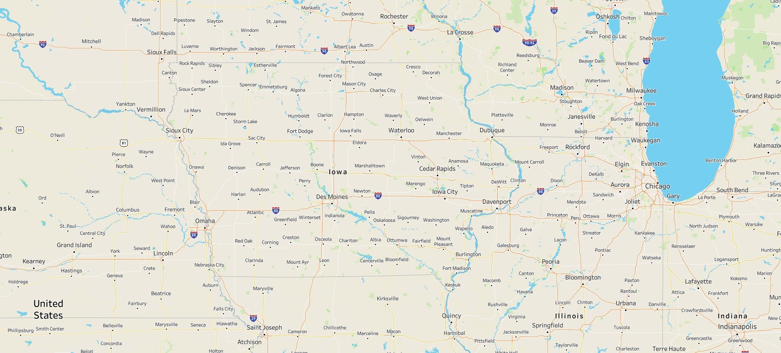


Top 15 Liquor Sales in IOWA
Sale Dollars
2,119,012
4,000,000
6,000,000
8,000,000
10,000,000
12,016,434
Sale Dollars
2,119,012 12,016,434
2,426,536
4,679,614
4,709,361
4,248,533
3,739,148
2,119,012
6,481,066
4,479,034
© 2023 Mapbox © OpenStreetMap

Slide 6
Most proﬁtable Category
Category
Proﬁt
American Vodkas
9,595,856
1,683,730
9,595,856
Canadian Whiskies
6,648,205
Straight Bourbon Whiskies
3,464,655
Cocktails /RTD
3,106,160
Blended Whiskies
2,816,073
Spiced Rum
2,638,069
Whiskey Liqueur
2,239,709
American Flavored Vodka
2,022,755
American Schnapps
1,787,008
American Cordials &
Liqueur
1,683,730
0K
500K
1000K
1500K
2000K
2500K
3000K
3500K
4000K
4500K
5000K
5500K
6000K
6500K
7000K
7500K
8000K
8500K
9000K
9500K
10000K
Proﬁt

Slide 7

Most proﬁtable item
Proﬁt
413,966
2,214,124
Hawkeye Vodka
Jim Beam
Five Star
Admiral Nelson Spiced Rum
Black Velvet
Five O'Clock Vodka
Fireball Cinnamon Whiskey
McCormick 80prf Vodka
McCormick 80prf Vodka PET
Titos Handmade Vodka

Slide 8
CONCLUSION
Some conclusions from the analysis obtained from the dashboard are:
1. Liquor sales in Iowa over the past 2 years show that Total sales and total profits have the same trend, the trend that occurs is very fluctuating so that in the last 2 years there has been no increase or decrease. with the most sales and profits obtained in certain months and occurred in December 2021 and 2022, this was due to Christmas and New Year, and then it’s also occurred in June 2020 due to the COVID-19 lockdown that happend in March-June 2020.
2. If we look at the map, it can be concluded that the cities that contribute the most total revenue from liquor sales in the state of IOWA are: Des Moines, Cedar Rapids, Davenport
3. The most profit obtained comes from product categories: American Vodkas, Canadian Whiskies, Straight Bourbon Whiskies

